Slide 1
Introduction to Reinforcement Learning and Bandit Problems
B. Ravindran
Reconfigurable and Intelligent Systems Engineering (RISE) Group
Department of Computer Science and Engineering
and Interdisciplinary Laboratory for Data Sciences (ILDS)
Indian Institute of Technology Madras

Slide 2
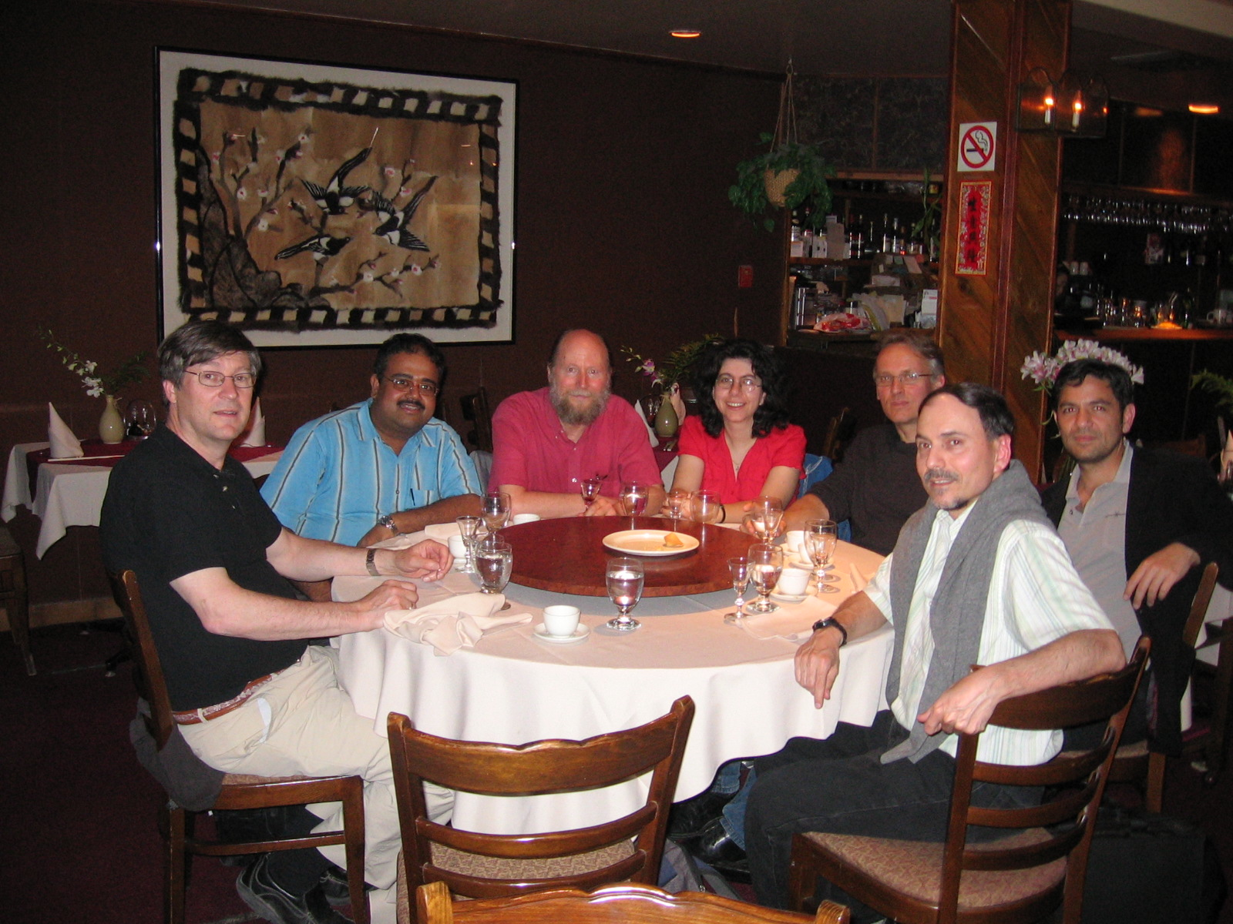
Introduction to Reinforcement Learning and Bandit Problems
B. Ravindran
Some slides borrowed from Sutton and Barto

Slide 3
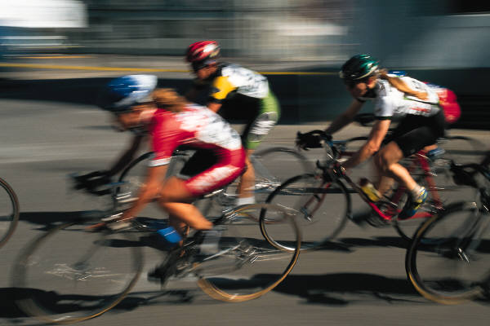
Learning to Control
Familiar models of machine learning
Supervised and unsupervised
Learning from data
How did you learn to cycle?
Not from Data!
Trial and error!
Falling down hurts!
Walking, Talking, etc.

Slide 4
Reinforcement Learning
A trial-and-error learning paradigm
Rewards and Punishments
Learn about a system through interaction
Inspired by behavioural psychology!
Pavlov’s dog

Slide 5
Temporal Difference
Simple rule to explain complex behaviors
Intuition: Prediction of outcome at time t+1 is better than the prediction at time t. Hence use the later prediction to adjust the earlier prediction.
Has had profound impact in behavioral psychology and neuroscience!

Slide 6

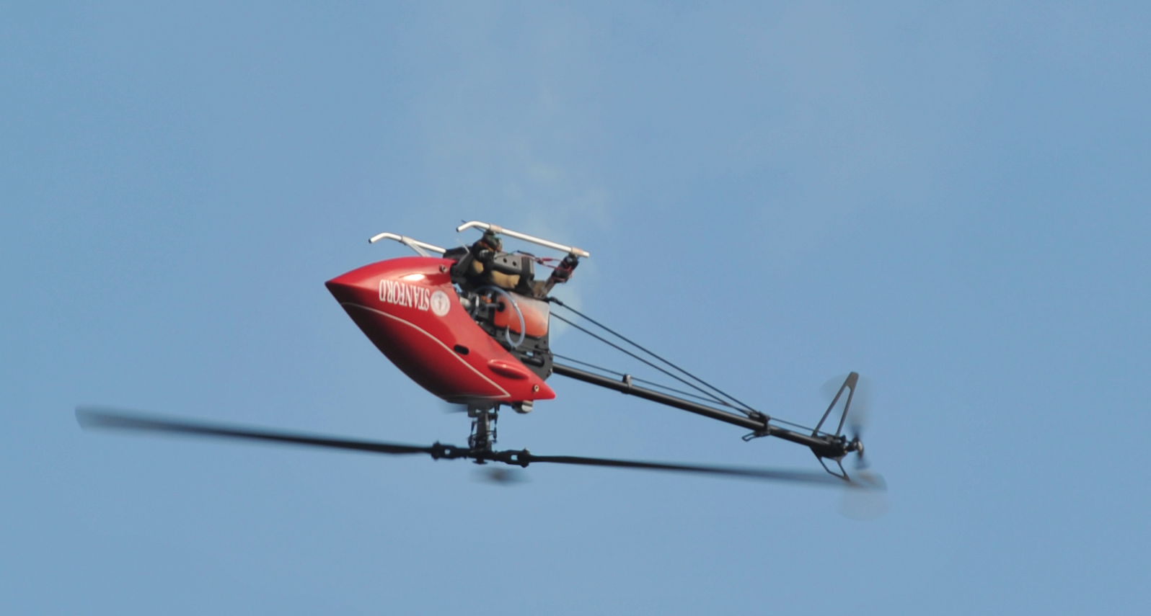
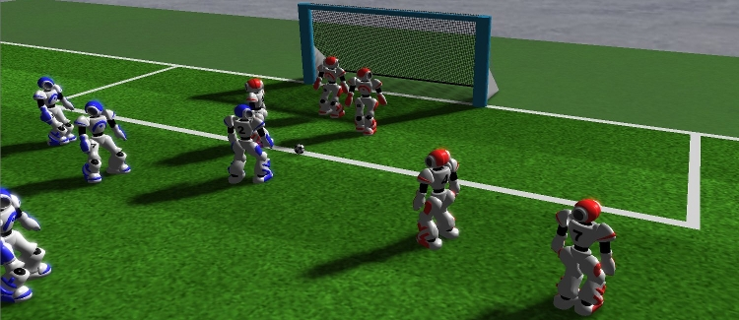
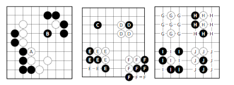
RL Applications

Slide 7
Explore-Exploit Dilemma
One key question - the dilemma between exploration and exploitation
Explore to find profitable actions
Exploit to act according to the best observations already made
Bandit problems encapsulate ‘Explore vs Exploit’

Slide 8

Multi-arm Bandits
n-arm bandit problem is to learn to preferentially select a particular action (arm) from a set of n actions (1, 2, 3, . . . . , n)
Each selection results in Rewards derived from the respective probability distribution
Arm i has a reward distribution with mean and

Slide 9
Customization

Slide 10
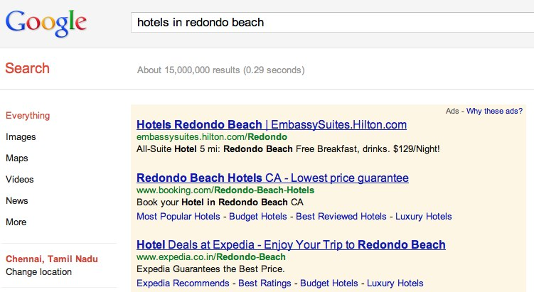
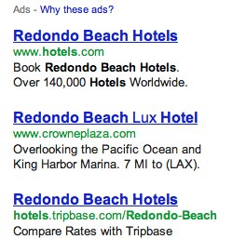
Ad Selection

Slide 11

Content Recommendation

Slide 12
Content Recommendation

Slide 13
Multi-arm Bandit
n-arm bandit problem is to learn to preferentially select a particular action (arm) from a set of n actions (1, 2, 3, . . . . , n)
Each selection results in Rewards derived from the respective probability distribution
Arm i has a reward distribution with mean and

Slide 14
Objectives
Identify the correct arm eventually
Maximize the total rewards obtained
Minimize regret (= loss) while learning

Slide 15
Objectives
Identify the correct arm eventually
Maximize the total rewards obtained
Minimize regret (= loss) while learning
Optimal
payoff

Slide 16
Objectives
Identify the correct arm eventually
Maximize the total rewards obtained
Minimize regret (= loss) while learning
Optimal
payoff

Slide 17
Objectives
Identify the correct arm eventually
Maximize the total rewards obtained
Minimize regret (= loss) while learning
Regret
Optimal
payoff

Slide 18
Objectives
Identify the correct arm eventually
Maximize the total rewards obtained
Minimize regret (= loss) while learning
Probably Approximately Correct (PAC) frameworks
Identification of an ε-optimal arm with probability
1 – δ
ε-Optimal: Mean of the selected arm satisfies
Minimize sample complexity: Order of samples required for such an arm identification

Slide 19
Traditional Approaches
Let be the reward sample acquired when arm is selected for the time
Define:
Epsilon Greedy: Select arm * with probability 1- and select any arbitrary arm with probability
Asymptotic Convergence Guarantees

Slide 20
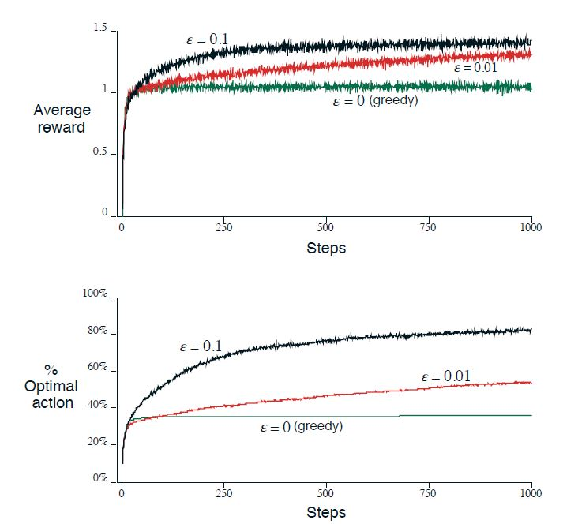
ε-Greedy Example

Slide 21
Other Approaches
Learning Automata (Narendra & Thathachar, 1989)
Median Elimination (Even-Dar et al., 2006)
Upper Confidence Bounds (UCB) (Auer et al., 1998, 2010)
Thompson Sampling (Chappelle & Li, 2001, Agrawal & Goyal, 2012)

Slide 22
UCB Auer et al, ICML 1998
Upper Confidence Bounds (UCB): The arm with the best estimate r∗ so far serves as a benchmark, and other arms are played only if the upper bound of a suitable conﬁdence interval is at least r∗
Simplest Approach – Be greedy with respect to upper confidence bounds

Slide 23
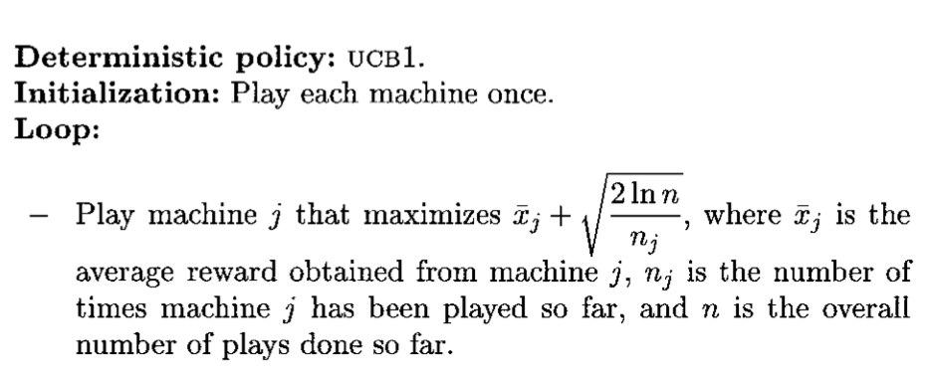
UCB Auer et al, ICML 1998
Sub-optimal arm j played fewer than (8/Δ_{j} ) ln n times
Further improvements focus on reducing the constants

Slide 24
Contextual Bandits
Different ads for different users
One bandit for each user!
Hard to train
Need several rounds of experience with same user
Typically users share features
Demographic
Browsing history
Location, etc.
“Arms” share features too!

Slide 25
Contextual Bandits
Assume that each user is represented by a set of features
Can be joint features of user and arm
The “statistic” used for choosing arms is now dependent on these features
Simplest case is to consider that for each feature combination you have a different bandit and once a choice is made there is a stochastic transition to another bandit
Earlier work on associative bandits
Typically use a small number of states to encode features

Slide 26
LinUCB Li et al., WWW10
One of the more popular contextual bandit algorithms
Predicted expected reward assumed to be a linear function of the features
Use ridge regression to fit parameters
Can derive upper confidence bounds for the regression fit
Use UCB like action selection
Gives better performance with lesser “training” data
Variants: Do not share parameters across arms

Slide 27
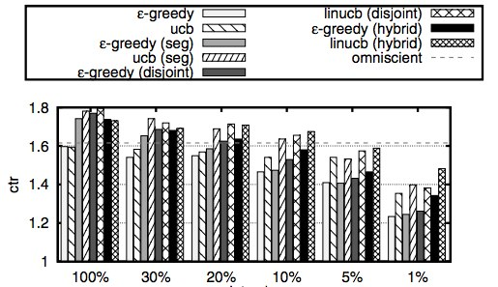
Improving CTRs

Slide 28
Current Status
More powerful approximations/sampling
GP-UCB, Srinivas et al., ICML 2010
Thomson Sampling for linear contextual bandits, Agrawal & Goyal, ICML 2013
Complex Dependencies
Multi-slot bandits
Budget Restrictions
Adversarial Bandits
Extensions to full reinforcement learning problem
PAC MDP Littman et al.
Optimal exploration Auer et al.
Exploration Bonus

Slide 29
References
ICML 2011 Tutorial on Bandits
https://sites.google.com/site/banditstutorial/
ICML 2010 and KDD 2010 Tutorial on Learning through exploration
http://hunch.net/~exploration_learning/
ICML 2011 Tutorial on Large Scale Recommender Systems
http://pages.cs.wisc.edu/~beechung/icml11-tutorial/
Some coverage of bandits for recommender systems

Slide 30
RL Framework
Environment
evaluation
State
Action
Agent
Learn from close interaction
Stochastic environment
Noisy delayed scalar evaluation
Maximize a measure of long term performance
Notes:
Benefits of RL.Applications.
Future rewards.
Situate in literature.. AI.
Stochastic systems.
Connections to OR.

Slide 31
The Agent-Environment Interface
. . .
r
t +1
r
t +2
r
. . .
s
s
t +1
s
t +2
t +3
s
t +3
t
a
a
t +1
a
t +2
a
t
t +3

Slide 32
The Agent Learns a Policy
Reinforcement learning methods specify how the agent changes its policy as a result of experience.
Roughly, the agent’s goal is to get as much reward as it can over the long run.

Slide 33
Returns
Episodic tasks: interaction breaks naturally into episodes, e.g., plays of a game, trips through a maze.
where T is a final time step at which a terminal state is reached, ending an episode.

Slide 34
Returns for Continuing Tasks
Continuing tasks: interaction does not have natural episodes.
Discounted return:

Slide 35
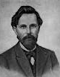
The Markov Property
“the state” at step t, means whatever information is available to the agent at step t about its environment.
The state can include immediate “sensations”, highly processed sensations, and structures built up over time from sequences of sensations.
Ideally, a state should summarize past sensations so as to retain all “essential” information, i.e., it should have the Markov Property:

Slide 36
Markov Decision Processes
If a reinforcement learning task has the Markov Property, it is basically a Markov Decision Process (MDP).
If state and action sets are finite, it is a finite MDP.
To define a finite MDP, you need to give:
state and action sets
one-step “dynamics” defined by transition probabilities:
reward expectations:

Slide 37
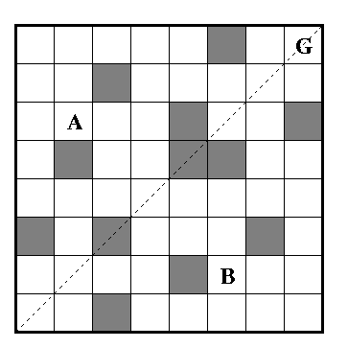
Example
N
W
E
S

Slide 38
Solving RL problems
Learn an optimal policy – a mapping from states to actions such that no other policy has a higher long term reward
Can learn such a policy directly
Or through estimating an optimal value function
Optimal Value function: The estimated long term reward that you would get starting from a state and behaving optimally

Slide 39
Why Value functions?
Let Q*(s,a) be the expected value of starting in state s and doing action a and behaving optimally thereafter.
Given the optimal value function one can recover the optimal policy easily

Slide 40
Q Learning
An incremental learning algorithm
Doesn’t need knowledge of the systems dynamics
Fully incremental
Learn through interaction with a system
. . .
r
t +1
r
t +2
r
. . .
s
s
t +1
s
t +2
t +3
s
t +3
t
a
a
t +1
a
t +2
a
t
t +3

Slide 41
Q Learning
An incremental learning algorithm
Doesn’t need knowledge of the systems dynamics
Fully incremental
Learn through interaction with a system
. . .
r
t +1
r
t +2
r
. . .
s
s
t +1
s
t +2
t +3
s
t +3
t
a
a
t +1
a
t +2
a
t
t +3
Temporal
Difference

Slide 42
Solution Methods
Temporal Difference Methods
TD(λ)
Q-learning
SARSA
Actor-Critic
Policy Search
Policy Gradient Methods
Evolutionary algorithms
Stochastic Dynamic Programming

Slide 43
Need for Generalization
Issues with large state/action spaces:
tabular approaches not memory efficient
data sparsity
continuous state/action spaces
We need methods that can generalize experience gained over a limited subset of the state space
Use a parameterized representation

Slide 44
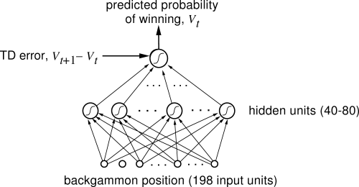
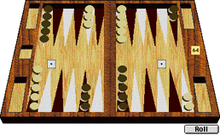
Human Level Backgammon player TD-Gammon (Tesauro 92)

Slide 45
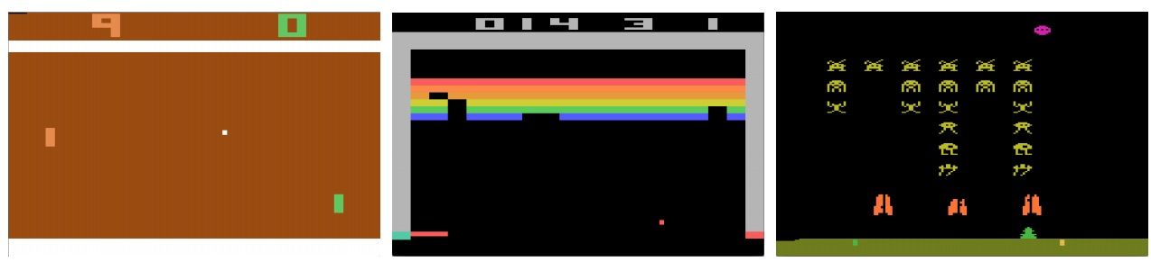
Game Playing – Arcade Games Minh et al., Nature 2015
Learnt to play from video input
from scratch
Used a complex neural network!
Considered one of the hardest learning problems solved by a computer.
More importantly reproducible!!

Slide 46
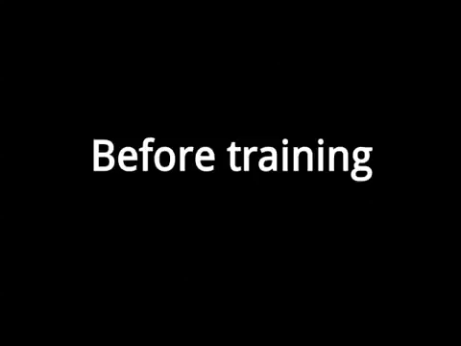
Google Deepmind’s Atari Player

Slide 47
Challenges
Scaling up!
Atari game playing takes several days to train
Perhaps it should?
Understand biological underpinnings of learning better
Practical Applications

Slide 48
References
Mitchell, T. Machine Learning. McGraw Hill. 1992
Russell, S. J. and Norvig, P. Artificial Intelligence – A Modern Approach. Pearson Educational. 2000.
Sutton, R.S. and Barto, A. G. Reinforcement Learning: An Introduction. MIT Press. 1998.
Dayan, P. and Abbott, L. F. Theoretical Neuroscience: Computational and Mathematical Modeling of Neural Systems. MIT Press. 2001.
Bertsikas, D. P. and Tsitsiklis, J. N. Neuro-Dynamic Programming. Athena Scientific. 1997.
Narendra, K. S. and Thathachar, M. A. Learning Automata: An Introduction. Courier Corporation. 2012.

Slide 49
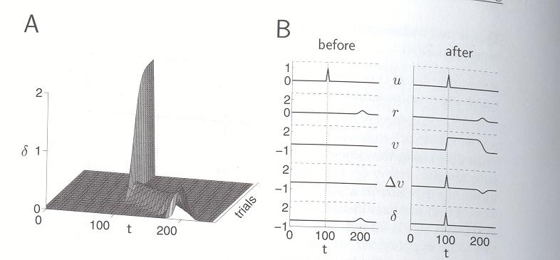
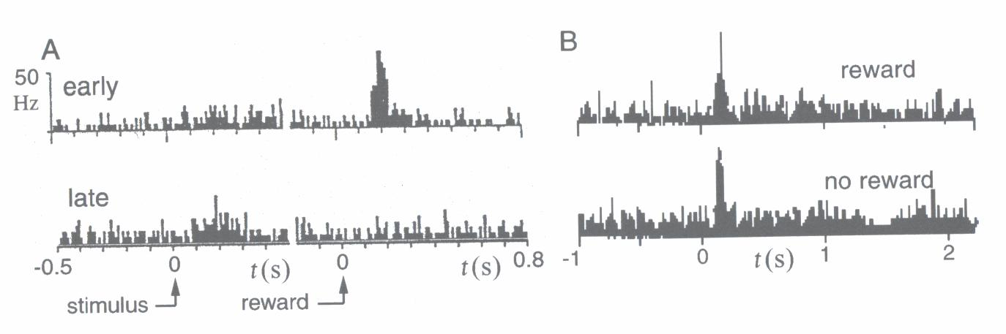
TD Prediction

